Slide 1
Enterprise Programming using JAVA
Chapter-2: Servlets
Prof. ARNIKA PATEL Assistant Professor
Department of CSE

Slide 2
Content
Servlets Configuration…....…………….………. 3
Servlet Context....……………………….…..………. 6
Servlet Collabration…………………………………... 9
INDEX

Slide 3
Servlets Configuration
ServletConfig in Servlet
javax.servlet.ServletConfig is an interface as a part of servlet API. For every Servlet class in our application, the web container will create one ServletConfig object and the web container will pass this object as an argument to the public void init(ServletConfig config) method of our Servlet class object.

Slide 4
Servlets Configuration
ServletConfig in Servlet
Some of the important points on ServletConfig are:
ServletConfig is an object containing some initial parameters or configuration information created by the Servlet Container and passed to the servlet during initialization.
ServletConfig is for a particular servlet, which means one should store servlet-specific information in web.xml and retrieve it using this object.

Slide 5
Servlets Configuration
ServletConfig in Servlet
Methods in the ServletConfig Interface
public abstract java.lang.String getServletName()
public abstract javax.servlet.ServletContext getServletContext()
public abstract java.lang.String getInitParameter(java.lang.String)
public abstract java.util.Enumeration<java.lang.String> getInitParameterNames()

Slide 6
Servlets Context
ServletContext is the object created by Servlet Container to share initial parameters or configuration information to the whole application.
Example: Suppose, the name of one’s job portal is “NewWebsite.tg”.
Showing the website name at the top of webpages delivered by different servlets, one needs to store the website name in every servlet inviting redundancy.

Slide 7
Servlets Context
Since the information shared by ServletContext can be accessed by every Servlet, it is better to go with ServletContext and retrieve the website name using getServletContext.getInitParameter(“Name”) whenever required.

Slide 8
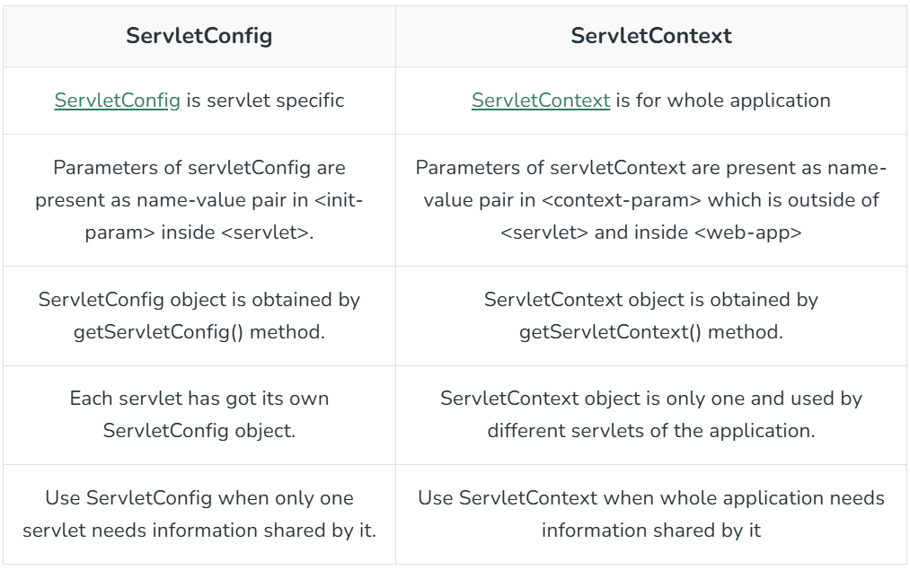

Slide 9
Servlets Collaboration
The exchange of information among servlets of a particular Java web application is known as Servlet Collaboration.
This enables passing/sharing information from one servlet to the other through method invocations.

Slide 10
Servlets Collaboration
What are the principle ways provided by Java to achieve Servlet Collaboration?
The servlet api provides two interfaces namely:
javax.servlet.RequestDispatcher
javax.servlet.http.HttpServletResponse

Slide 11
Servlets Collaboration
Using RequestDispatcher Interface
The RequestDispatcher interface provides the option of dispatching the client’s request to another web resource, which could be an HTML page, another servlet, JSP etc. It provides the following two methods:
public void forward(ServletRequest request, ServletResponse response)throws ServletException, java.io.IOException:

Slide 12
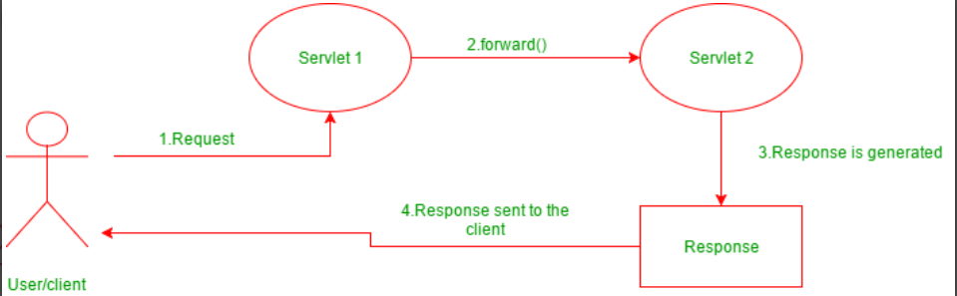
Servlets Collaboration
Using RequestDispatcher Interface

Slide 13
Servlets Collaboration
Using RequestDispatcher Interface
public void include(ServletRequest request, ServletResponse response)throws ServletException, java.io.IOException:
The include() method is used to include the contents of the calling resource into the called one.
When this method is called, the control still remains with the calling resource. It simply includes the processed output of the calling resource into the called one.

Slide 14
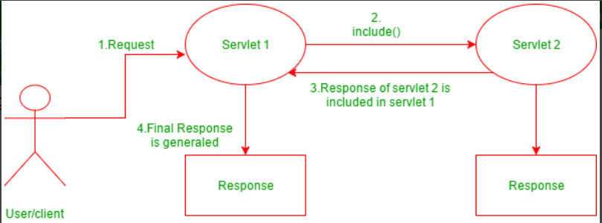
Servlets Collaboration
Using RequestDispatcher Interface

Slide 15
Servlets Collaboration
Using HttpServletResponse Interface
The HttpServletResponse interface is entrusted with managing Http responses. To achieve servlet collaboration, it uses the following method:
public void sendRedirect(String URL)throws IOException;
This method is used redirect response to another resource, which may be a servlet, jsp or an html file. The argument accepted by it, is a URL which can be both, absolute and relative. It works on the client side and uses the browser’s URL bar to make a request.

Slide 16
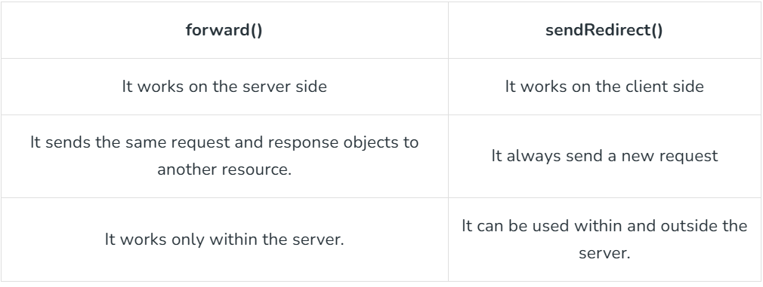
Servlets Collaboration
What is the difference between forward() method of RequestDiispatcher and sendRedirect() of HttpServletResponse?

Slide 17
PPT Content Resources Reference Sample:
Book Reference Jim Farley, William Crawford, David Flanagan. Java Enterprise in a Nutshell, O'Reilly
Book Reference
Rocha, R., Purificação, J. (2018). Java EE 8 Design Patterns and Best Practices: Build Enterprise-ready Scalable Applications with Architectural Design Patterns. Germany: Packt Publishing..
Website Reference
https://www.scribd.com/document/268349254/Java-8-Programming-Black-Book .
Sources
https://developers.redhat.com/topics/enterprise-java
Article
https://www.researchgate.net/publication/276412369_Advanced_Java_Programming

